Slide 1
The Role of School-Based Transportation in School Choice: Evidence from Detroit
Jeremy Singer, Michigan State University
Sarah Winchell Lenhoff, Wayne State University
REACH in collaboration with the
Detroit Partnership for Education Equity & Research

Slide 2
Motivation
Despite significant expansion of school choice options in many urban areas, school transit availability has not expanded at the same rate
Nationally, about the same percentage of students ride the school bus today (38%) as they did in the 1960s (Kontou et al., 2020)
As students have enrolled in schools further from home, more have relied on their families to drive them rather than walk or bike
School transportation availability can therefore create inequity in who has access to educational opportunity, creating mobility injustice (Bierbaum et al., 2021; Lenhoff et al., 2022; Speroni & Lenhoff, 2023)

Slide 3
Prior Literature
In NYC, Trajkovski et al. (2021) found that proximity and school bus availability both mattered for kindergarten enrollment. Although distance to school mattered, school bus availability increased the likelihood of enrollment, even more than school quality did.
In Detroit, Edwards (2021) found that students were more likely to enroll in their assigned school if they lived in areas with greater poverty and less car ownership. In addition, students were less likely to enroll in their assigned school if they lived further away from it and were therefore more likely to be eligible for the school bus.
In New Orleans, Valant and Lincove (2023) found that car access is significantly associated with school choice preferences and enrollment.
Notes:
Sam: Tract-based choice set with 2+ students
Danielle: if any student in Detroit attends the school
Reference JEP and AERA Open papers, too

Slide 4
Our Study
Prior research confounds school bus availability and eligibility or does not take into account the school transportation resources available in the full choice set.
In this study, we measure both availability of the school bus at a given school and eligibility, or a student’s reasonable likelihood of being able to use the school bus that is available. We then ask:
How is access to school-based transportation
related to students’ school choices in Detroit?

Slide 5
Study Context: Detroit
Fragmented school choice landscape, with little transparency or regulation
Detroit resident students can enroll in any DPSCD school, any charter school in the city or suburbs, and hundreds of suburban public schools through interdistrict choice
Schools are not required to offer transportation to choice students
DPSCD offers transportation only to students enrolled in their assigned school who live more than 0.75 miles away
50% of the schools Detroit students attend offer no transportation

Slide 6
Data
We use student-level administrative records from Michigan’s Center for Educational Performance and Information which include demographics, school enrolled, and census block of student’s home for all students who live in Detroit and attend any public school in Michigan
We conducted an audit of school transportation policies, calling each school enrolled by any Detroit student in 2021-22 to confirm the transportation offered and any rules for accessing it, including the bus stop locations
We geo-coded the bus stop locations to determine each student’s distance from each school’s bus stops
We also interviewed families in Detroit about how and why they chose the schools they did. We coded excerpts in which families mentioned school transportation as being relevant to their choices, and we present findings from that analysis to supplement the quantitative analysis.

Slide 7
Transit Offered at Schools Enrolled by Detroit Students
 | All | DPSCD Neighborhood | DPSCD App/Exam | Detroit Charter | Suburban TPS | Suburban Charter
Traditional | 75 (22%) | 59 (100%) | 3 (21%) | 8 (16%) | 3 (2%) | 2 (3%)
Shuttle-Style | 27 (8%) | - | - | 11 (22%) | 3 (2%) | 13 (19%)
None | 234 (70%) | - | 11 (79%) | 31 (62%) | 139 (96%) | 53 (78%)
Total | 336 (100%) | 59 (100%) | 14 (100%) | 50 (100%) | 145 (100%) | 68 (100%)

Slide 8
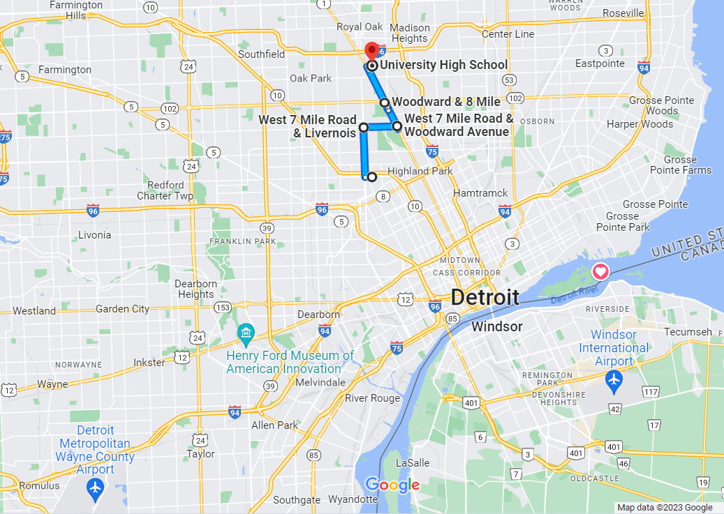
Example of Limited Shuttle Bus Stops: University High School
4 bus stops in Detroit
Notes:
Note: students can board AT STOPS, not at any point along the way

Slide 9
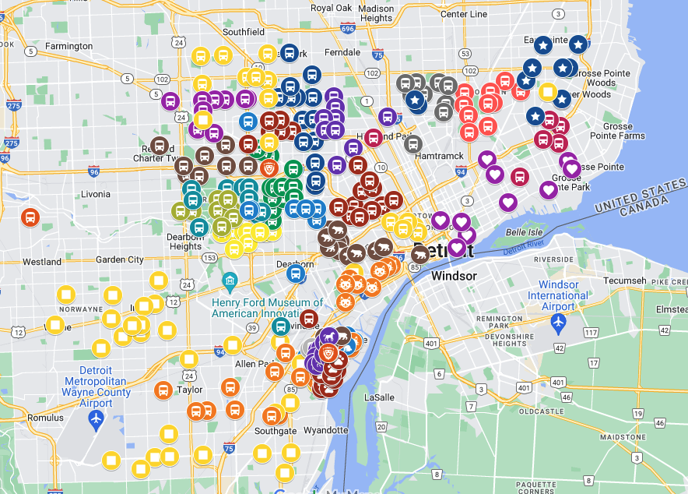
Example of Expansive Shuttle Bus Stops: River Rouge
Nearly 300 bus stops in Detroit and other nearby suburbs

Slide 10
Transportation Availability and Eligibility Definitions
Available = Any type of school bus offered to DETROIT students
Eligible
DPSCD: District rules = Enrolled in assigned school and live 0.75 miles away
Charter/suburban shuttle: lives 1mi or less from shuttle stop
Charter/suburban traditional: based on specific rules (e.g., within 3mi of school; some cases no restrictions)
Eligibility by type: traditional, shuttle, none
Notes:
Note that some schools suggest a capacity limit on buses but we don't account for that in our rule
"loop" is included in shuttle
Definitions of types: https://detroitpeer.org/wp-content/uploads/2022/09/7.-School-Transportation-Policies-in-Detroit-ACCESSIBLE.pdf

Slide 11
Methods
We employed a discrete choice model (McFadden, 1974) to predict the odds a student would enroll in a school with their choice set given the school’s transportation resources.
We focus on three transportation variables:
Transportation available
Transportation eligible
Transportation type (none, traditional school bus, shuttle bus)
We constructed choice sets for students by census tract, to include all schools offering K and attended by at least one student in the tract, plus their assigned school and chosen school. (We excluded alternative and virtual schools.)
Notes:
Choice set: any school offering K attended by a student in your tract
sam: tract-based choice sets
danielle: if *any* student attends
(ref danielle and sam as justification)

Slide 12
Kindergarten Student Characteristics, 2021-22
Variable | N | Mean | Std. dev. | Min | Max
Economically Disadvantaged | 6,538 | 0.92 | - | 0 | 1
Special Education Recipient | 6,538 | 0.07 | - | 0 | 1
English Learner | 6,538 | 0.09 | - | 0 | 1
Female | 6,538 | 0.49 | - | 0 | 1
Black | 6,538 | 0.83 | - | 0 | 1
Hispanic | 6,538 | 0.09 | - | 0 | 1
White or Middle Eastern | 6,538 | 0.04 | - | 0 | 1
Other Race/Ethnicity | 6,538 | 0.03 | - | 0 | 1
Distance to School (mi) | 6,538 | 4.14 | 4.47 | 0.07 | 43.18
DPSCD Neighborhood School | 6,538 | 0.40 | - | 0 | 1
Suburban TPS | 6,538 | 0.06 | - | 0 | 1
DPSCD App/Exam School | 6,538 | 0.05 | - | 0 | 1
Detroit Charter | 6,538 | 0.34 | - | 0 | 1
Suburban Charter | 6,538 | 0.15 | - | 0 | 1
Number of Schools in Choice Set | 6,538 | 49.37 | 18.19 | 4.00 | 93.00
Notes:
Note: median dist2sch is smaller
Includes X% of kindergarteners

Slide 13
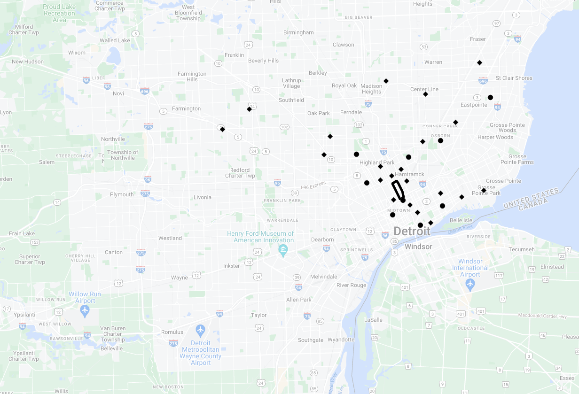
Example Choice Sets
Smaller choice set: 30 schools (~1SD below mean)
Notes:
Note: median dist2sch is smaller

Slide 14
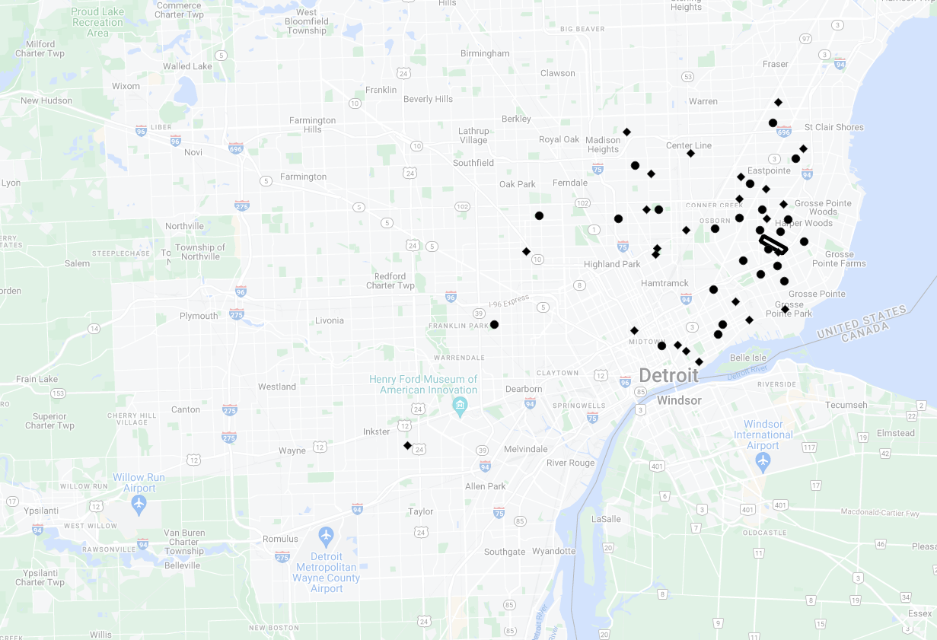
Example Choice Sets
Average choice set: 49 schools
(at mean)
Notes:
Note: median dist2sch is smaller

Slide 15
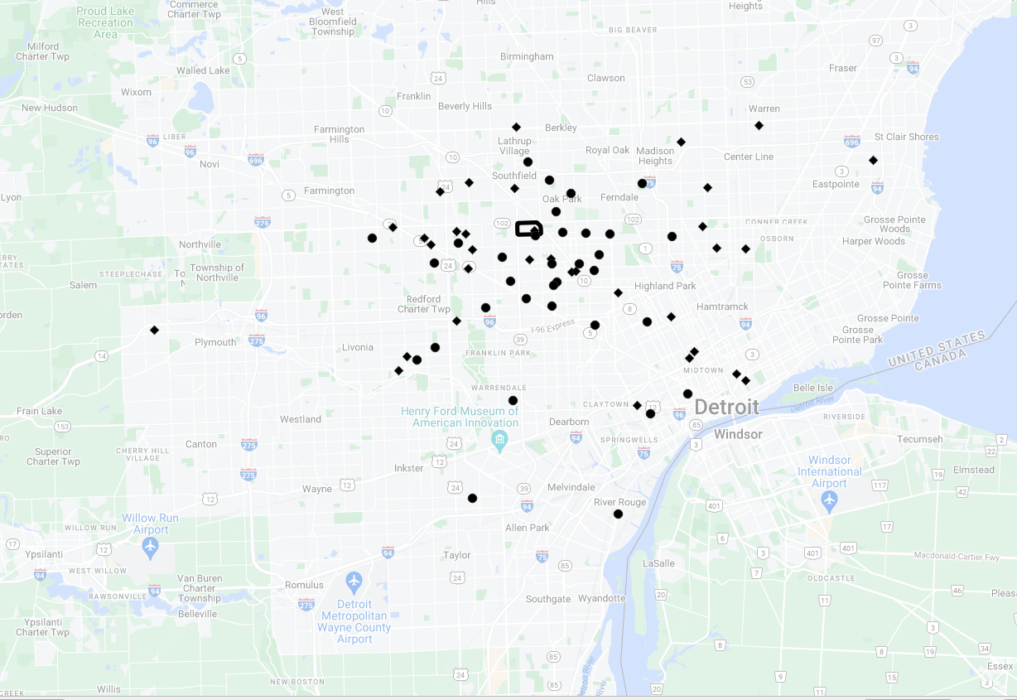
Example Choice Sets
Larger choice set: 67 schools (~1SD above mean)
Notes:
Note: median dist2sch is smaller

Slide 16
Kindergarten Choice Set Characteristics, 2021-22
Variable | N | Mean | Std. dev. | Min | Max
Distance to Choice (mi) | 287 | 7.26 | 1.46 | 2.98 | 10.64
Pct. of Neighbors Attending Choice | 287 | 0.03 | 0.02 | 0.01 | 0.25
DPSCD Neighborhood School | 287 | 0.30 | 0.09 | 0.07 | 0.60
Suburban TPS | 287 | 0.09 | 0.06 | 0.00 | 0.37
DPSCD App/Exam School | 287 | 0.10 | 0.06 | 0.00 | 0.38
Detroit Charter | 287 | 0.34 | 0.09 | 0.15 | 0.75
Suburban Charter | 287 | 0.17 | 0.08 | 0.00 | 0.33
Transportation Offered | 287 | 0.49 | 0.09 | 0.18 | 0.80
Transportation Eligible | 287 | 0.10 | 0.05 | 0.00 | 0.50
Notes:
287 unique choice sets of K, meaning 287 different tracts
Interpret variables as avg for choice set; for example, the avg distance to choices ranges from 3mi to 10.6mi. Or, for the avg choice set, the share of students eligible for transit ranges from 0% to 50%
SWL change var names

Slide 17
Model (part 1)
Pr(Y_{ik} = k) =
e^{Zikβ}
Σ_{k}e^{Zikβ}
The probability that for a given student (i), their chosen school (Y) will be choice k, as a function of choice characteristics (Z), expressed as an odds ratio​.

Slide 18
Model (part 2)
^{Zikβ} = β1(School Typek) + β2(Distance to Choiceik) + β3(School Demographicsk) + β3(School Transportationk) + β4(School Qualityk) µi + εik
School type = DPSCD neighborhood, DPSCD app/exam, Detroit charter, suburban charter, suburban TPS
Distance to choice = as-crow-flies, in miles
School demographics = racial and socioeconomic composition
School transportation = offered, eligible , or eligible by type
School quality = MI School Index Score (2019)
µ = student fixed effects (allowing for within-choice-set analysis)
Notes:
Note: we also run the model separately for different categories of block-group car ownership (Valant & Lincove), to see if bus eligibility importance differs w/ this rough proxy for individual car ownership

Slide 19
Methods
We complement our discrete choice model findings with qualitative data from parent interviews:
54 interviews, February-April 2022
Interviews focused on parents' school-choosing, asking about the full history of their school choices for all children
Interviews are not exclusively focused on Kindergarten choice, but offer some insight into why we find positive associations between school-based transportation and school choices

Slide 20
Findings

Slide 21
 | (1) Transportation Offered | (2) Transportation Eligible | (3) Transportation Eligible by Type
Choice Type (ref=DPSCD neighborhood)
DPSCD app/exam | 0.81** | 0.75*** | 0.75***
Detroit charter | 1.07 | 0.96 | 0.96
Suburban charter | 1.23*** | 1.12* | 1.12*
Suburban TPS | 0.86* | 0.74*** | 0.74***
Choice Demographics
Pct. Economically Disadvantaged+ | 1.11*** | 1.12*** | 1.12***
Pct. Black+ | 1.04 | 1.04 | 1.04
Pct. Hispanic+ | 1.01 | 1.01 | 1.01
Pct. of Neighbors Attending Choice+ | 1.39*** | 1.38*** | 1.38***
Distance to Choice (mi) | 0.85*** | 0.86*** | 0.86***
MI School Index Score (2019) | 1.01*** | 1.01*** | 1.01***
Transp. Offered | 1.15*** | - | -
Transp. Eligible | - | 1.35*** | -
Transp. Eligibility Type (ref=none)
Traditional school bus | - | - | 1.33***
Shuttle-style bus | - | - | 1.45***
N students | 6,538 | 6,538 | 6,538
N student-observations | 300,487 | 300,487 | 300,487
*p<0.05, **p<0.01, ***p<0.001
Discrete Choice Model Predicting Enrollment

Slide 22
Discrete Choice Model Predicting Enrollment
Notes:
SWL change var names

Slide 23
 | (1) <66% Cars (<-1 S.D.) | (2) 66-81% Cars (-1 to 0 S.D.) | (3) 81-96% Cars (0 to 1 S.D.) | (4) 96-100% Cars (>1 S.D.)
Choice Type (ref=DPSCD neighborhood)
DPSCD app/exam | 0.74 | 0.71** | 0.79* | 0.77
Detroit charter | 0.90 | 0.89 | 0.96 | 1.32*
Suburban charter | 0.91 | 1.12 | 1.12 | 1.42**
Suburban TPS | 0.59* | 0.73** | 0.75** | 0.93
Choice Demographics
Pct. economically disadvantaged+ | 1.23*** | 1.16*** | 1.10** | 1.01
Pct. Black+ | 1.12 | 1.01 | 1.06 | 0.95
Pct. Hispanic+ | 1.11 | 0.96 | 1.04 | 0.95
Pct. of neighbors attending choice+ | 1.31*** | 1.37*** | 1.41*** | 1.41***
Distance to choice (mi) | 0.86*** | 0.86*** | 0.85*** | 0.87***
Michigan School Index score (2019) | 1.01*** | 1.01*** | 1.01*** | 1.01***
Transp. Eligibility Type (ref=none)
Traditional school bus | 1.44*** | 1.47*** | 1.23** | 1.21
Shuttle-style bus | 1.18 | 1.19 | 1.78*** | 1.44
N students | 896 | 2,108 | 2,800 | 734
N student-observations | 33,546 | 97,726 | 135,612 | 33,603
*p<0.05, **p<0.01, ***p<0.001
Discrete Choice Model Predicting Enrollment by Block Group Pct. Car Ownership
Note: Coefficients are presented as odds ratios.
+Variables are standardized, and coefficients represent the odds associated with a standard-deviation change.

Slide 24
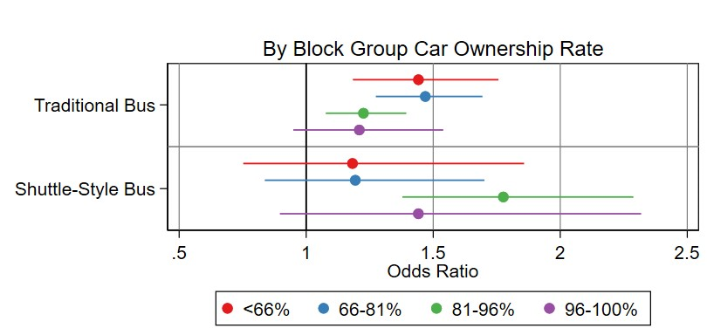
Discrete Choice Model by Block Group Pct. Car Ownership

Slide 25
How School Transportation Shapes Families' Choices
Families factor school buses into their choice set, especially if they lack transportation resources or have schedule constraints.
I knew we only had the one car [which my husband uses for work], and that I would need them to get on the bus. And then the other school, I can't think of the name it... they wouldn't pick up here. We were off by like two blocks. So the only option I did have was [our neighborhood school].
I always put them in school, whatever school is in the area where we live...I did it that way because it would be easier for them to get to school, like, to be put on the [school bus] transportation route and, um, to get there, if we had to walk or whatever.
Notes:
First example: this parent only considered schools where her kids might be eligible for the bus. She chose the school where they were eligibile

Slide 26
How School Transportation Shapes Families' Choices
School-based transportation increases access for families who face geographic and transportation-related constraints.
In the mornings they tend to get up at 5:30 in the morning because their bus comes to the stop...I have a newborn, so I'm not always able to take them to the bus stop. So [if I can't bring them to the stop] my mom would have to take them...Because my husband goes to work at three or four o'clock in the morning, he's not able to take them.
Notes:
This parent described why her children ride the bus to school. The example highlights the multiple factors that shape "getting to school" and how buses can aid to some extent with that.

Slide 27
How School Transportation Shapes Families' Choices
Now we had moved...and [the principal] put a bus stop right by my house for my kids to go back to [the school], and they end up going back to [that school]...Every time I moved, [the principal] made a bus stop by my house.
Notes:
This parent moved farther away from the charter school she had chosen, and faced geographic constraints. She switched her children to the neighborhood DPSCD school for just a couple days, but was unsatisfied and wanted to keep them in their charter.

Slide 28
Summary of Findings
School transit availability was associated with 15% greater odds of enrollment.
School transit eligibility was significantly associated with enrollment. Students had 35% greater odds of enrolling in a school where they were eligible for school-based transportation.
Overall, estimates for shuttle-style transportation were larger but much less precise than for traditional school bus transportation.
Estimates differed notably based on block group-level car ownership rates.
Even controlling for transit eligibility, distance to school is associated with a decreased likelihood of enrollment.

Slide 29
Discussion
Difficulty of measuring transportation eligibility in a fragmented choice landscape
Persistent effect of distance

Slide 30
Let us know what you think!
Sarah.Lenhoff@wayne.edu

Slide 31
Student Characteristics by Sample Inclusion, 2021-22
Variable | Included (N=6,538) | Excluded (N=1,239)
Economically Disadvantaged | 0.92 | 0.90*
Special Education Recipient | 0.07 | 0.05*
English Learner | 0.09 | 0.14***
Female | 0.49 | 0.50
Black | 0.83 | 0.80**
Hispanic | 0.09 | 0.12**
White or Middle Eastern | 0.04 | 0.06*
Other Race/Ethnicity | 0.03 | 0.02
Distance to School (mi) | 4.13 | 4.04
DPSCD Neighborhood School | 0.39 | 0.21***
Suburban TPS | 0.06 | 0.05
DPSCD App/Exam School | 0.05 | 0.12***
Detroit Charter | 0.34 | 0.40***
Suburban Charter | 0.15 | 0.21***
*p<0.05, **p<0.01, ***p<0.001
Notes:
Excluding students who were missing data for:
-school transit
-residential block (no choice set constructed!)
-other key vars (e.g., composite index)
Overall, we are able to keep about 84% of Kindergarteners in the analytic sample
(also, population is defined to exclude student at alt and virtual schools, and choice sets exclude those students)

