Slide 1
Parent Sensemaking and School Choices Amidst Educational Controversies
Sarah Winchell Lenhoff, Kate Meza, Whitney Miller, Julie Marsh, Dwuana Bradley
REACH in collaboration with the
Detroit Partnership for Education Equity & Research

Slide 2
National discourse around school choice has shifted
Way for racially and economically marginalized students to escape failing, mostly urban schools
(Jabbar et al., 2022)
Way for more advantaged, often white students to escape “radical” public schools that implement COVID-19 protocols, teach the Civil Rights Movement, and honor students’ gender identities
(Butcher, 2023)

Slide 3
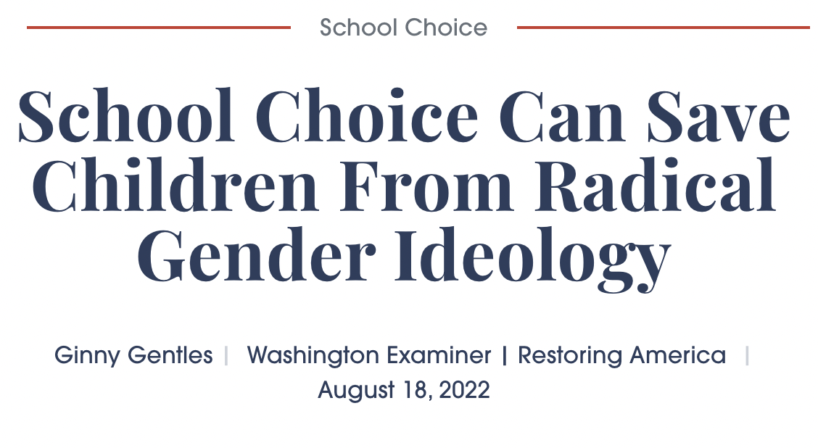
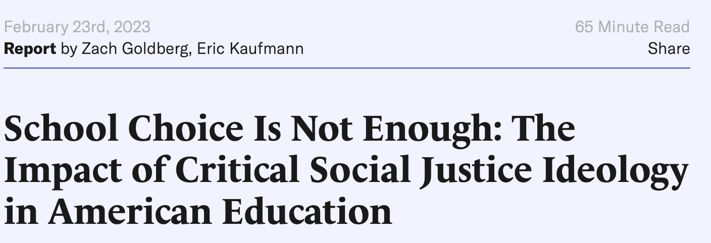
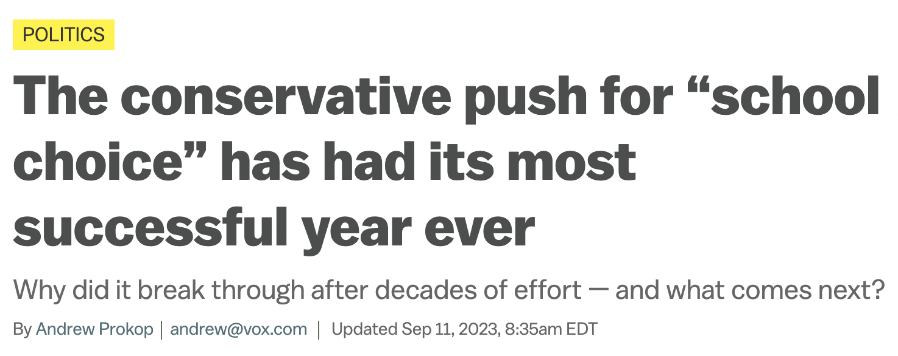
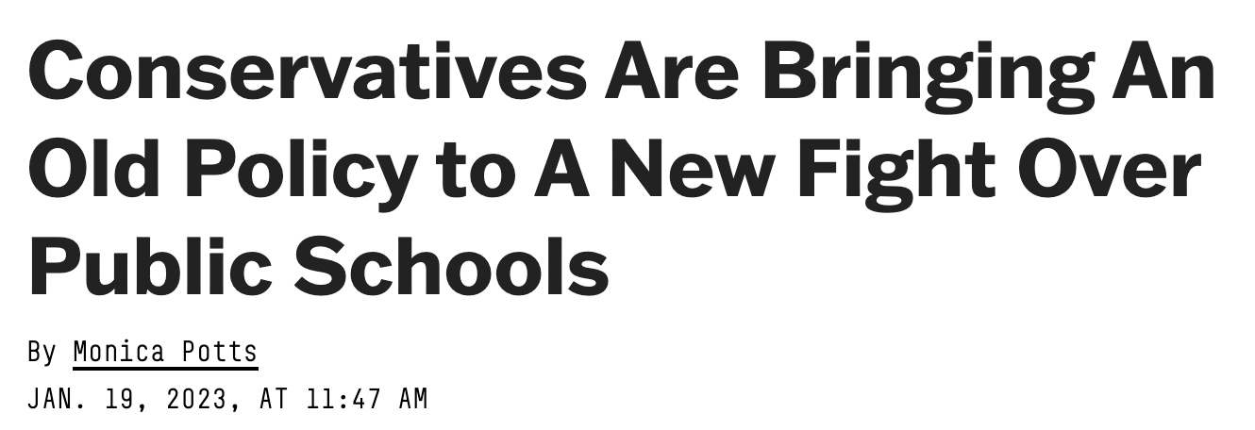
Notes:
Rufo
How messages trickle into major and social media
Use literature on political memes
1619 project and backlash
Trans rights around bathrooms/spo, drag queen story hours and backlash

Slide 4
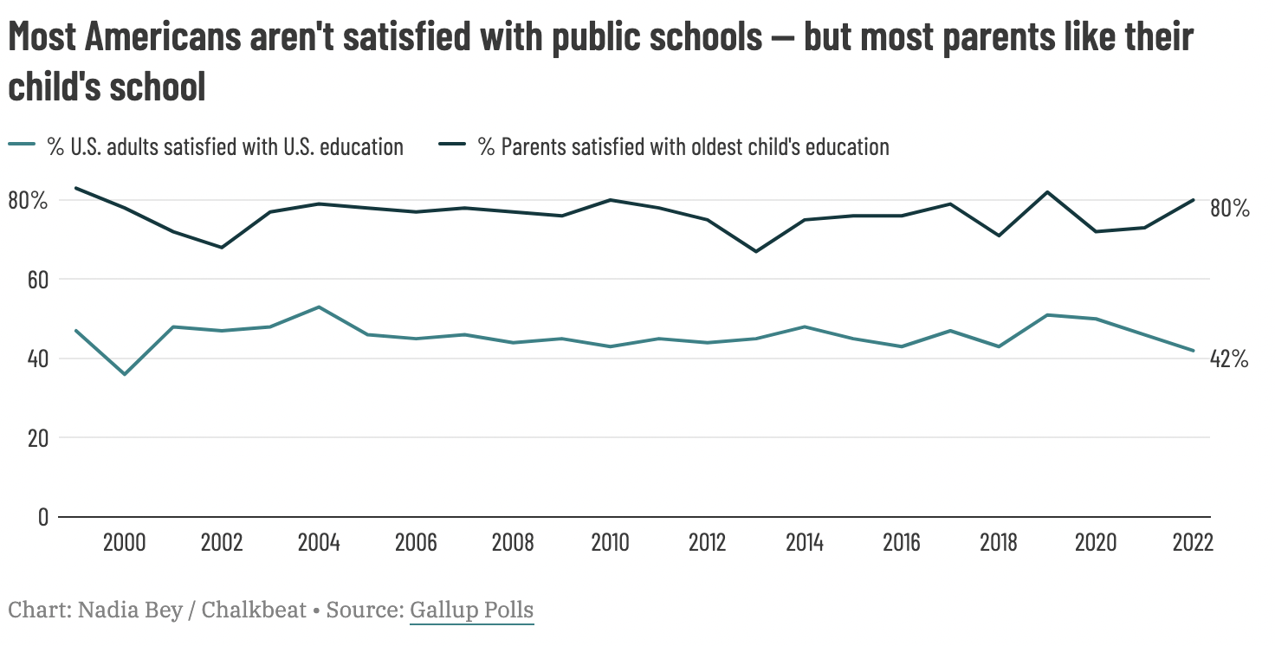
Parents’ Views of Public Schools Differ From Other Adults

Slide 5
Our Study
We explore how parents interpreted the political discourse around controversial education issues between 2021-2023 and how those interpretations shaped their schooling decisions.
We answer two research questions:
How did parents make sense of the national political discourse around K-12 schools in 2021-2023?
How did parents’ sensemaking within the sociocultural context around controversial education issues inform their choices, satisfaction, and relationships with their children’s schools?

Slide 6
Sociocultural Theory: Our Context
Sociocultural Theory emphasizes the interaction between people and their environment and how that interaction is subjected to various and continuous ‘tensions and contradictions’ (Vygotsky, 1978, 1986; Aasen, 2014; Apple, 1993).
Internal constraints or symbolic tools aligned with our beliefs, values, and subjectivities
External constraints which are both material and structural
We used this perspective to help us understand the most salient internal and external factors that affect parents' actions and opinions regarding 'the school of their choice’

Slide 7
Data Collection Methods
We conducted a longitudinal multisite qualitative study by first recruiting parents in six cities (Denver, Detroit, Miami, New Orleans, Portland, and Washington, D.C.) during the 2020-21 school year through a survey research firm
Participants were asked whether they wanted to opt into an interview about their school choice experiences. Among those who opted in, we interviewed 56 parents in 2020-21.
In the winter of 2022-23 we contacted those 56 parents and recruited 35 to participate in follow-up interviews.
We used a matrix coding scheme where we asked questions of the data and recorded answers for each interview in a spreadsheet.
We then looked across interviews to identify themes and wrote a memo for each question we asked of the data.

Slide 8
Interviewers and Interview Questions
Multiracial interview team with varying gender and sexuality identities: 4 Black, 4 white, 1 Hispanic (Spanish-speaking)
Semi-structured interview with follow-up probes to provide depth and clarity. Questions included:
What are the big issues facing education nationally?
Are there any local debates about teaching race or gender/sexuality in schools?
What are your thoughts on these debates?
Have or would you change schools based on these issues?
Notes:
Note: students can board AT STOPS, not at any point along the way

Slide 9
Study Demographics
 | Number | Percent
State/City
Colorado | 10 | 29%
Florida | 5 | 14%
Louisiana | 4 | 11%
Michigan | 3 | 9%
Oregon | 9 | 26%
Washington, D.C. | 4 | 11%
School Type*
TPS | 26 | 70%
Charter | 6 | 17%
Private/Home School | 5 | 14%
*Two families had children in two different school types, accounting for the more than 35 students.

Slide 10
Study Demographics
 | Number | Percent
Race
Black | 10 | 29%
White | 14 | 40%
Hispanic | 5 | 14%
Other | 6 | 17%
Income*
<$75,000 | 8 | 22%
>$75,000 | 18 | 51%
Political Party
Democrat | 23 | 66%
Republican | 5 | 14%
Independent/Unaffiliated | 7 | 20%
*Six respondents did not offer income information

Slide 11
Findings Overview
National discourse creating confusion
Varying ideas about what Critical Race Theory is
Myths promoted by media around transgender students
Sociocultural context matters
Combined, parents have a more complex interpretation of controversial educational issues than the national discourse would suggest
Parents are more satisfied with how their schools are responding to these issues than national discourse would suggest
Parents were not making school choice decisions based on these issues. What parents do care about is . . .

Slide 12
Parents were overwhelmingly satisfied with how schools addressed race and racism
80% of our respondents were in support of their schools teaching about race/racism
“I think they do a good job of any racial issue that comes up. They do kind of discuss it with the kids, so when my kids do come home, they are aware of it, and they do want to get our take on it and everything like that…. I think it’s better that they learn in a learning situation rather than just hearing certain things from friends. I would like them to be as educated as possible, as open-minded as possible.”
–A mixed-race parent in Washington D.C. who identified as a Democrat
Notes:
Note: median dist2sch is smaller

Slide 13
Some Parents Conflicted, One Parent Opposed
Conflicted (n=4): “[W]hat's important is the narrative, which direction it's going to be going in. People have hidden agendas and it might be right on paper like, "Oh, this is a great idea," but it would be something totally different in the end. So I'm wanting to know details.”
-a Black Democrat mother in Michigan
Opposed (n=1): “[W]e have a Republican governor that's been on record and on television saying they don't stand for critical race theory and gender crap and all that. Won't allow it. And whoever does teach it [is] going to suffer the consequences. So I'm totally supportive.”
-a white Republican father from Florida
Notes:
Note: median dist2sch is smaller
Includes X% of kindergarteners

Slide 14
Schools Could Be Doing More
Many parents wanted their schools to do more, especially when they saw racism in their own schools.
A mixed-race mother who identified as a strong Democrat shared about her own school:
“I don't know if this is conscious, unconscious, mildly conscious, who knows what. My son has two sections right now. They put all the kids of color, black, brown, whatever, anything into one classroom and all the white kids into the other classroom. And then there's two non-white kids in the other classroom and they're higher economic status… And I don't even think that the school, the community kind of even notices or realizes it."
Notes:
Note: median dist2sch is smaller

Slide 15
Sociocultural Context Shapes Parent Sensemaking
Parents of different races reasoned that the diversity of their schools led to either a lack of race conflict or the presence of it.
White and Hispanic parents were more likely to credit the diversity of their schools with the lack of conflict
Black parents were more likely to credit their homogenous student bodies for the lack of race-based conflict.
Mixed-race families discussed heightened levels of tension and conflict.
Other parents reasoned that the majority of the debates were happening in other locations, like southern states or rural areas:
“I have a friend actually who just quit teaching in Florida because of their policies and connection with CRT and her belief that she didn't sign up to push children to be ignorant. So she quit. So I know it's a big thing in Florida, in Texas.”-A Black Democrat mother in D.C.
Notes:
Note: median dist2sch is smaller

Slide 16
Majority of Parents Support Anti-Bullying Programs Related to Gender/Sexuality
When asked if they supported teaching about gender and sexuality in schools, 57% parents were in support, 29% felt conflicted, 11% were against.
Parents were most comfortable with anti-bullying forms of education. They expressed a desire for their children to be knowledgeable about different kinds of people.
"I would want that to be taught, so kids can learn and hopefully there wouldn't be as much bullying and more understanding."
-A white Democratic mother in Colorado
From another parent on why she supported her school: “Well, there's a lot of teaching about being respectful of preferred pronouns. They had a whole section in health about gender identity.” –A Black Democrat mother in D.C.
Notes:
Note: we also run the model separately for different categories of block-group car ownership (Valant & Lincove), to see if bus eligibility importance differs w/ this rough proxy for individual car ownership

Slide 17
Many Parents Felt Conflicted
Respondents who were conflicted were fearful that the curriculum would not be age appropriate or would consume too much of their children’s school day
However, many of these same parents were also in support of anti-bullying measures and tolerance education.
“I don't know that I have a strong opinion one way or the other. I don't know that I want all my children's time focused on it. I want them to know to be open-minded and that everybody has a choice, and we accept their choices, whatever it is. But I want my kids to also learn stuff that they need to learn in school.” –A mixed-race parent in D.C., Independent
Notes:
Note: we also run the model separately for different categories of block-group car ownership (Valant & Lincove), to see if bus eligibility importance differs w/ this rough proxy for individual car ownership

Slide 18
Some Parents Did Not Want Issues Related to Gender/Sexuality Taught in Schools
“I do not feel that gender or sexuality should be taught in schools. Why would sex be at the forefront of education? I feel like that should be taught by the parents.”- Black moderate Democrat mother in Michigan

Slide 19
School-Level Experiences with LBGTQ+ Identities
Two parents had LGBTQ children and discussed how this impacted their school and social experiences. A white Democrat mother shared how well her school had embraced her own child:
“[M]y daughter does identify differently than heterosexual. But I think the teachers are somewhat understanding. She has a friend that's biologically a girl, but she calls her a he. My daughter calls her friend… a he, even though biologically her friend is female. And she's mentioned other friends in similar situations.”
A white Democrat Mother in Louisiana who was part of a home-school collative shared the consequences of being out that her daughter could experience:
“So it was kind of hard because it's like, if she were to have a girlfriend that would be an issue in the school that she's in and the co-op in. They would not be happy with that, and they would not accept her. They would actually kick her out. I mean, they would. They would reject her. They would kick her out”

Slide 20
Confusion Stemming From National Media Narratives
Very few parents we spoke to had a clear understanding or definition of the term Critical Race Theory. This confusion was persistent across race, political party, and state. Social media would sometimes become a playing field for parent sensemaking.
“I think it was something on Facebook. It was a post, and I didn't understand it…I'm like, is it something that people think is racist? Is that why it's negative?”
Several parents brought up a myth about schools providing litter boxes for students who identified as Furries, a narrative stemming from anti-transgender rhetoric
Notes:
287 unique choice sets of K, meaning 287 different tracts
Interpret variables as avg for choice set; for example, the avg distance to choices ranges from 3mi to 10.6mi. Or, for the avg choice set, the share of students eligible for transit ranges from 0% to 50%
SWL change var names

Slide 21
Controversies Not a Driver of School Choice Decisions
No parents changed schools as a result of race controversies. Only a few of the participants discussed acting on these experiences. Instead, families were most likely to engage in conversations within their home, schools, and larger community.
Only two parents discussed having responses or actions in response to gender and sexuality education in schools.
No families changed schools as a result of LGBTQ+ discourse or studies.
The most common action was to have conversations at home.

Slide 22
Implications for School Leaders
Parents appreciated schools that communicated explicitly about these issues with parents, asking them for feedback
Parents are interested in and capable of considering the complexities involved in these issues, across political identities
Local school actions and context seem to matter more than national discourse
Schools could be doing more to address racism and gender-based bullying in schools, not just teaching about the relevance of these issues outside of schools
Notes:
Excluding students who were missing data for:
-school transit
-residential block (no choice set constructed!)
-other key vars (e.g., composite index)
Overall, we are able to keep about 84% of Kindergarteners in the analytic sample
(also, population is defined to exclude student at alt and virtual schools, and choice sets exclude those students)

Slide 23
Let us know what you think!
Sarah.Lenhoff@wayne.edu

